Slide 1





NEWAGE
Kentaro Miuchi
KOBE University
K. Nakamura⁽²⁾, Y. Yamaguchi⁽¹⁾ , T.Hashimoto⁽¹⁾, R. Yakabe⁽¹⁾, T. Ikeda⁽¹⁾, R.Taishaku⁽¹⁾
T.Tanimori⁽²⁾, K.Kubo⁽²⁾, A.Takada⁽²⁾, H.Nishimura⁽²⁾, J.D.Parker⁽²⁾, T.Mizumoto⁽²⁾, Y.Mizumura⁽²⁾, Y.Matsuoka⁽²⁾, S.Komura⁽²⁾, A.Takeda⁽³⁾, H.Sekiya⁽³⁾,
Contents
  NEWAGE
  Kamioka RUN14 results
  PTEP (2015) 043F01s
  R&D status
(1) Kobe university
(2) Kyoto university
(3) ICRR

Slide 2
Announcemens:
CYGNUS and more
JSPS “Brain circulation program”
(Program for Advancing Strategic International Networks to Accelerate the Circulation of Talented Researchers)
  We can invite “young” staff researchers.
  Dan, Neil, James and Sven
  We can invite some more in 2015, 2016.
  We are happy to make some joint papers!

Slide 3
NEWAGE

Slide 4
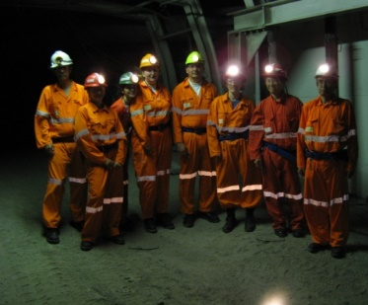
NEWAGE
μ-PIC based TPC with electronics
3-D tracks
Proposal
PLB 578 (2004) 241-246
First direction-sensitive DM limits
  PLB654 (2007) 58
Underground results
PLB686 (2010) 11, PTEP (2015) 043F01s
Phase for “low BG detector”
CYGNUS 07

Slide 5
NEWAGE strategy since its new ages
size
DRIFT
diffusion
BG
Radon
gas study
gammas
to
quenching
z-fiducialization
stability
energy resolution
position resolution
Hashimoto
DISCOVERY
neutrons
energy threshold
exclusion limit
head-tail
NEWAGE
Miuchi
skymap
20keV
F 1mm
10Torr CF4
angular resolution
DIRECTIONALITY

Slide 6
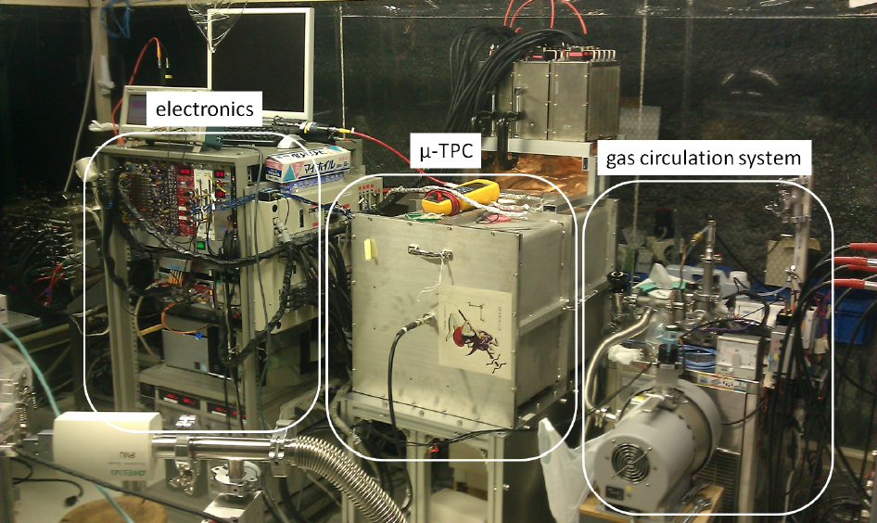
NEWAGE detector
NEWAGE-0.3b’
Detection Volume: 31×31×41cm³
Gas: CF4 at 0.1atm (50keVee threshold)
Gas circulation system with cooled charcoal

Slide 7
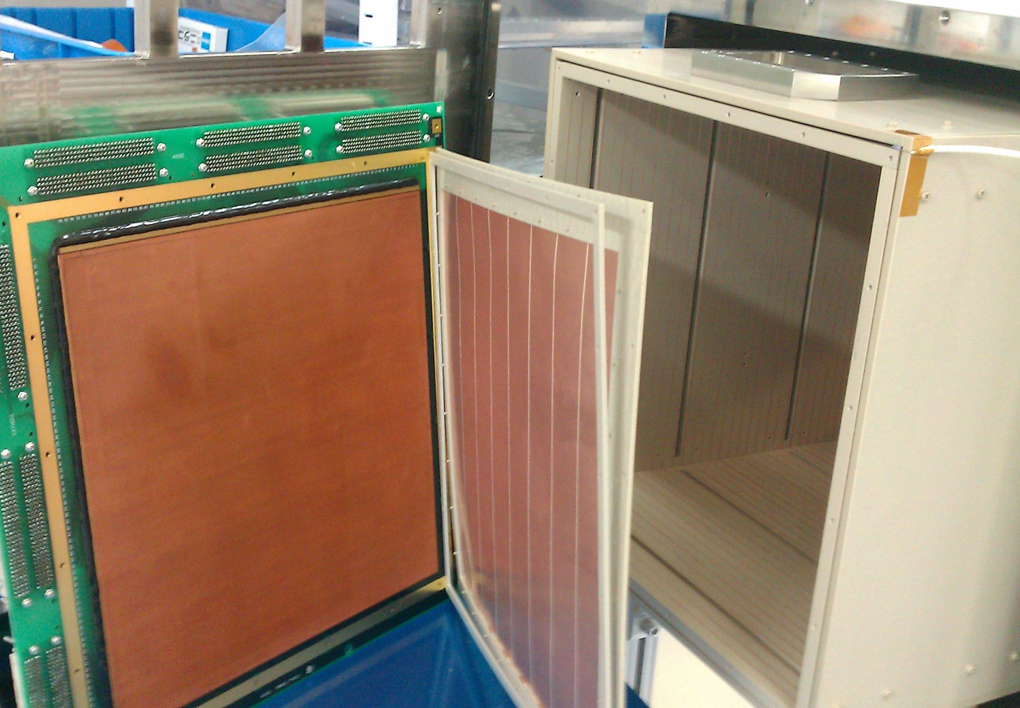
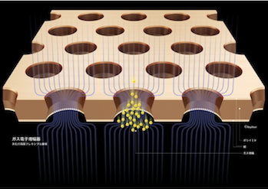
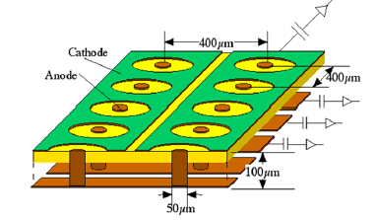
NEWAGE-0.3b’ inside view
  Detection Volume: 30×30×41cm³
Field cage
Drift length: 41cm
PEEK + copper wires
GEM
- 31×32 cm²
- 8-segmented
- hole pitch : 140μm
- hole diameter: 70μm
- insulator : LCP 100μm
- gain : ~5
- made by Scienergy, Japan
μ-PIC(Micro-pixel chamber)
- 31×31cm²
- pitch : 400μm
- gain : ~1000
- made by DNP, Japan

Slide 8
NEWAGE-0.3b’ readouts
  μ-PIC is X-Y readout
  General purpose
  FPGA-based electronics
  since early 2000’s.
  Updates are always
  on-going
256ch connector
NEWAGE-0.3b’ (inside)
256ch ASD box
FPGAs

Slide 9
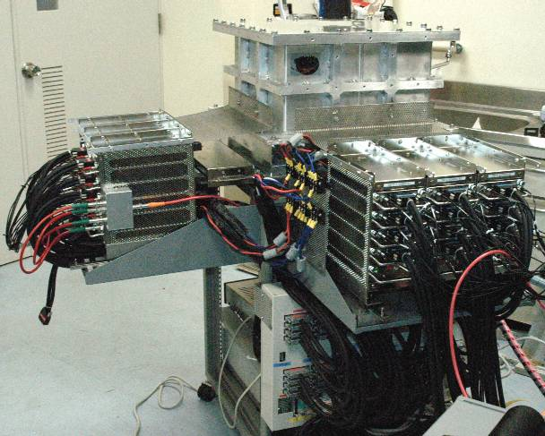
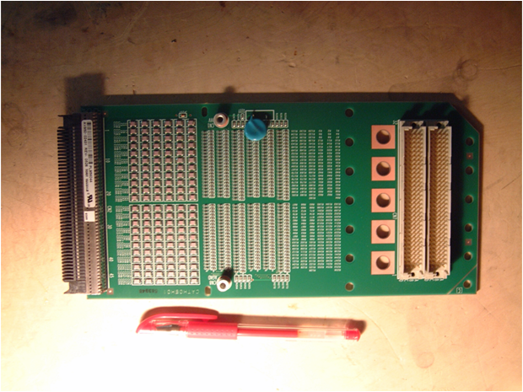
  1500ch feedthrough
    feedthrough board
    everything is out of the vessel
    easy to maintain
    keep the gas purity
256ch feedthrough board
TPC volume
O-ring
board
O-ring

Slide 10
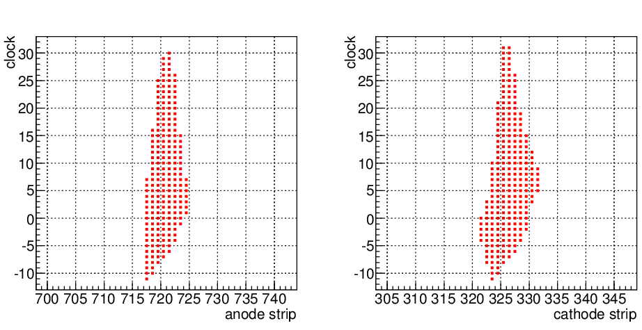
NEWAGE-0.3b’ data
  TOT of every strip by FPGA (clock 100MHz)
  ⇒3D tracks, headtails in X,Y
  +
  Summed waveforms by FADC (100MHz)
  ⇒energy, headtails in Z
combined ⇒ PID, absolute z
TOT
(time-over-threshold)
“raw track data” sample

Slide 11
NEWAGE-0.3b’ performance
  Energy threshold: 50keV
  Energy resolution:
  20% (dominated by gain non-uniformity)
  Nuclear track detection efficiency: 40% @50keVee
  Gamma rejection 2.5E-5@50keVee
  angular resolution 40°@50keVee

Slide 12
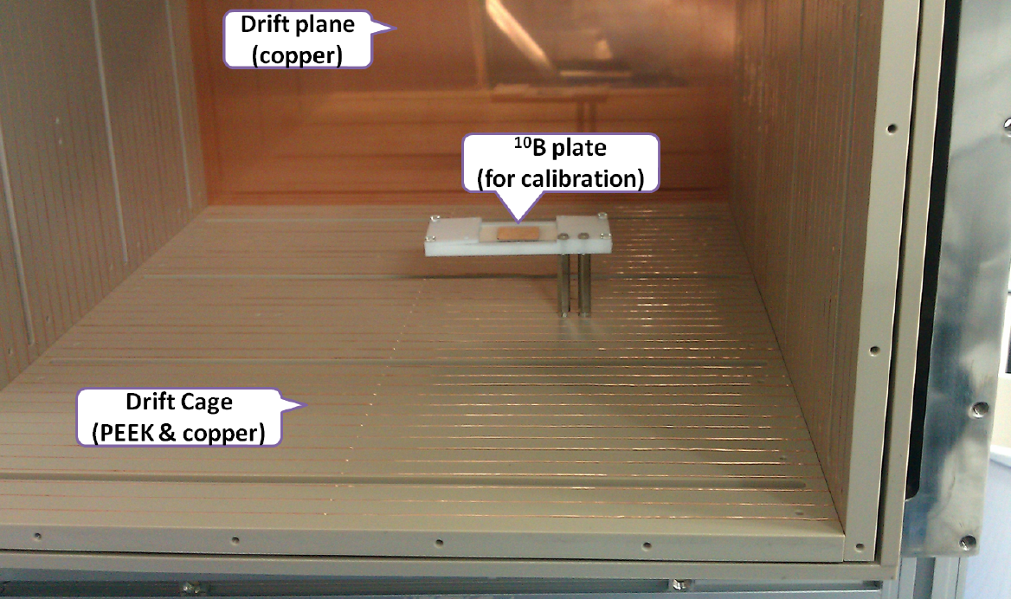
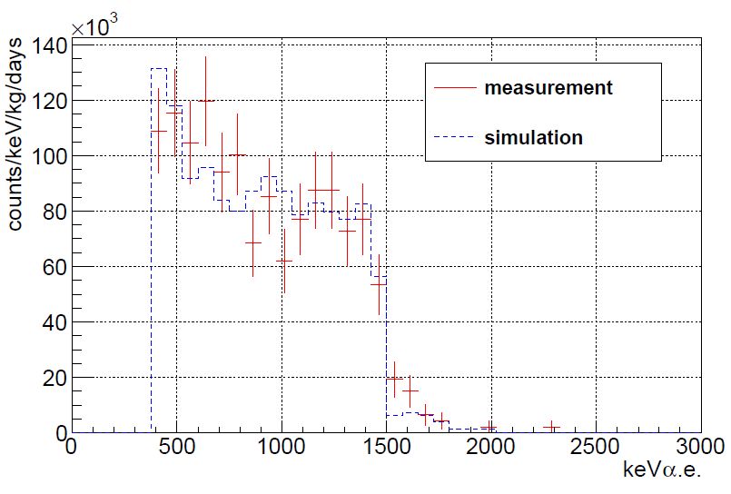
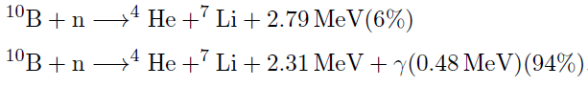
NEWAGE-0.3b’ : calibration
  α’sfrom ¹⁰B(n,α)⁷Li reaction
  10B plate stays in the TCP
  irradiated with thermalized neutrons
10B cal
  linearity check: 1.5MeV+ 5.9keV, 6MeV

Slide 13
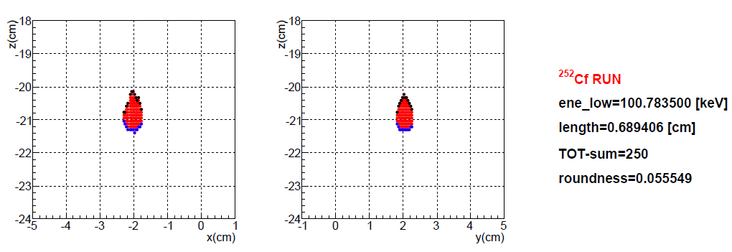
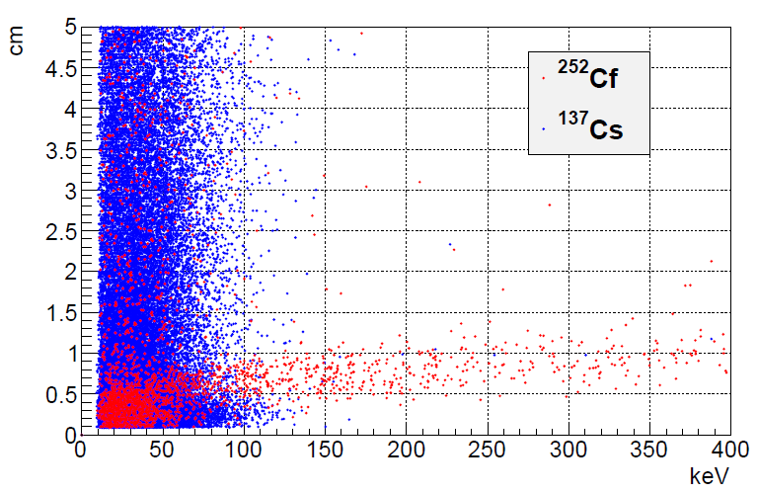
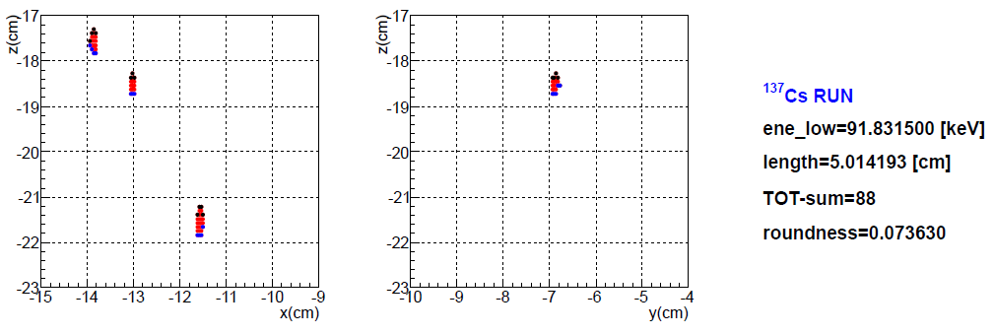
Event selection 1
length-cut (conventional gamma-ray cut)
dE/dx : nuclear (²⁵²Cf) > electron (¹³⁷Cs)
track length : electron > nuclear
energy vs length
short
long

Slide 14
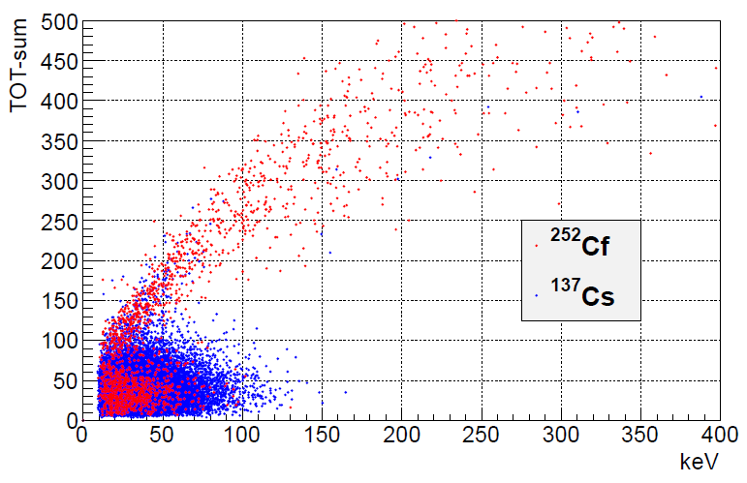
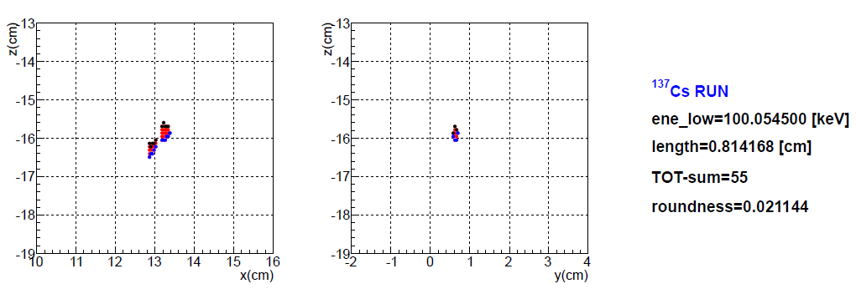
Event selection 2
TOT-sum-cut (new gamma-ray cut)
Nuclear (²⁵²Cf)：TOT-sum is proportional to energy
Electron (¹³⁷Cs)：scratched track (small dE/dx)
energy vs TOT-sum
large (area)
small

Slide 15
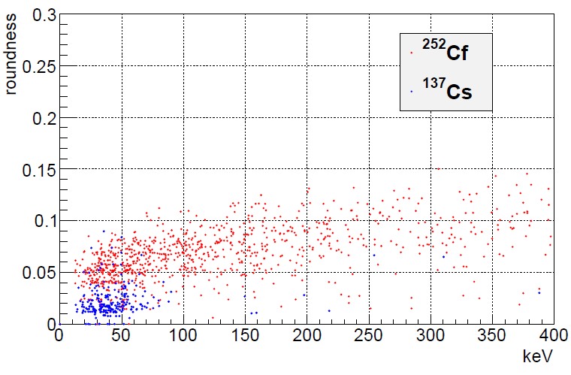
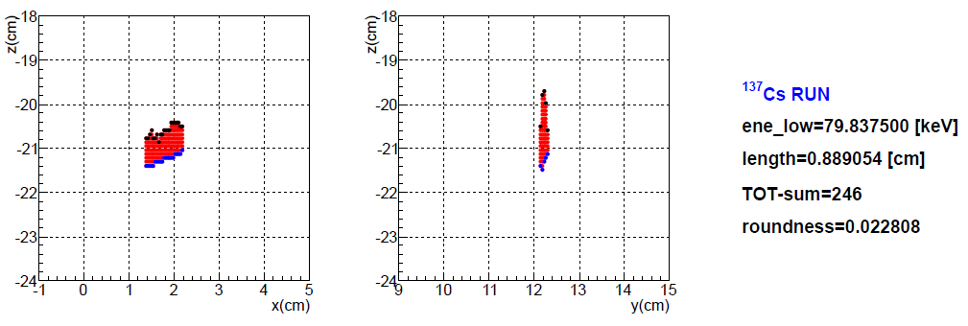
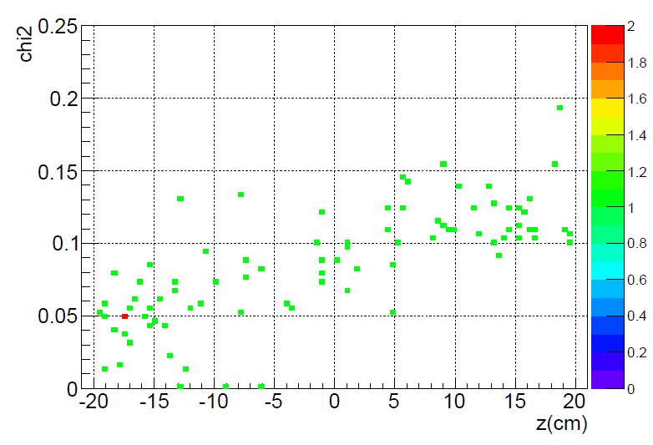
Event selection 3
roundness-cut (third cut)
  Remained ¹³⁷Cs events : straight track shape
energy vs roundness
large roundness
straight (small roundness)
z vs roundness
external-trigger + DAQ-mode5
²⁵²Cf-run
roundness
Diffusion (drift distance) affects roundness !
(Almost all electron events are cut)
(Remained events are BG α from μ-PIC)
Roundness-cut works as “z-fiducial-cut”

Slide 16
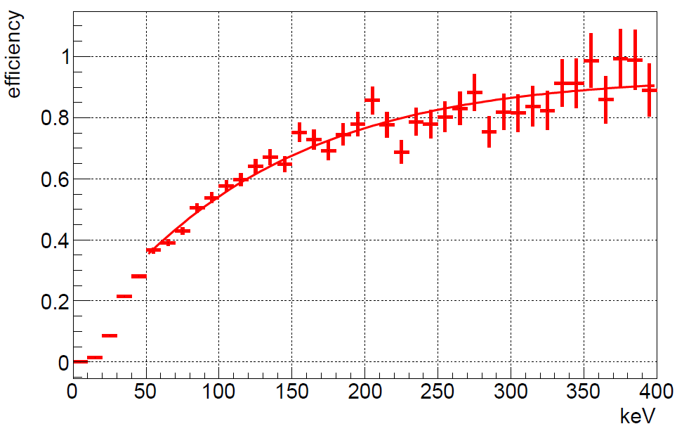
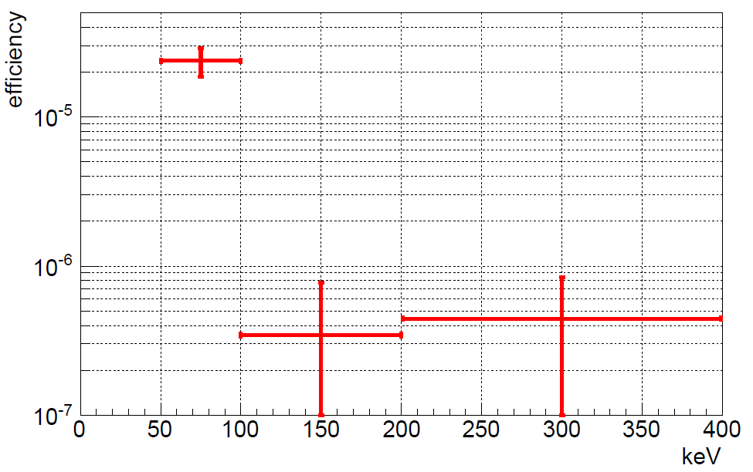
Efficiency
原子核事象の検出効率
After all cut, compare to Geant4
Nuclear (²⁵²Cf neutron source)
  Efficiency : 40%@50keV
Electron (¹³⁷Cs γ source)
  Rejection : 2.5×10⁻⁵@50-100keV
電子事象の検出効率

Slide 17
NEWAGE
Kamioka RUN14 results

Slide 18
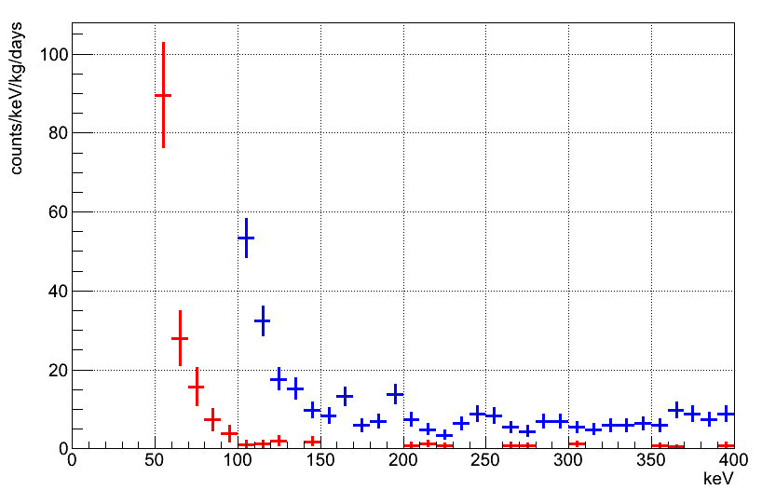
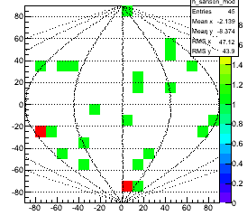
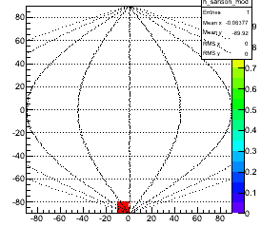
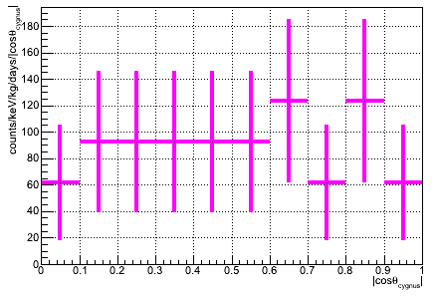
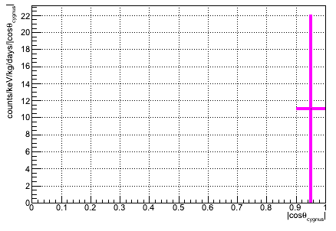
NEWAGE underground run
Energy spectrum
RUN14
period : 2013/7/20-8/11, 10/19-11/12
live time : 31.6 days
fiducial volume：28x24x41cm³
mass : 10.36g
exposure : 0.327 kg・days
RUN5 (NEWAGE-0.3a)
RUN14 (NEWAGE-0.3b)
Energy spectrum
  Threshold : 100 => 50keV
  BG rate : 1/10@100keV
Skymap, cosθ distribution
  Set limit by significant difference in 2-binned measured cosθ and DM-wind simulated cosθ
skymap
cosθ distribution
50-60keV
100-110keV

Slide 19
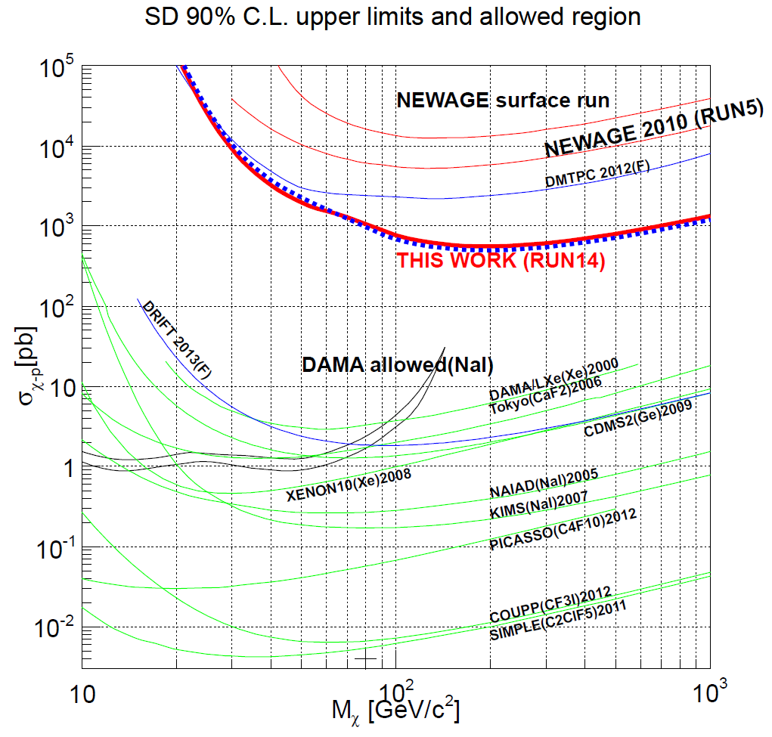
Direction-sensitive limit
red : gas, with directional analysis
blue : gas, without directional analysis
green : solid, liquid detector
Obtained limit : 557pb @200GeV
  (Best direction-sensitive limit)
Improved one order of magnitude from previous RUN5

Slide 20

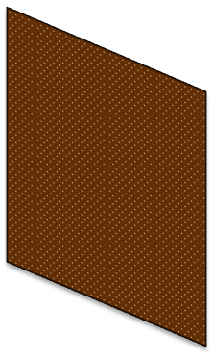
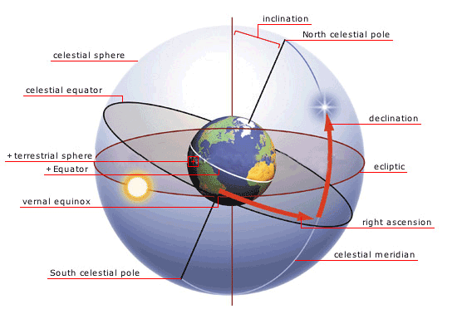
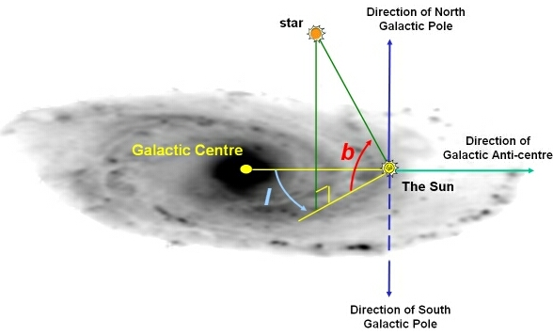
Galactic-plane sky-map
  Demonstration for direction sensitivity
Detector Coordinate
Lab frame
X
N
μPIC
W
E
N
E
θ
30°
elevation
φ
S
Z
W
latitude
S
Y
Z
+時間情報
declination
galactic latitude
right ascension
galactic longitude
galactic coordinate
equatorial coordinate
Notes:
30㎝角のμPIC+30㎝のdriftを使ったガスTPCです。

Slide 21
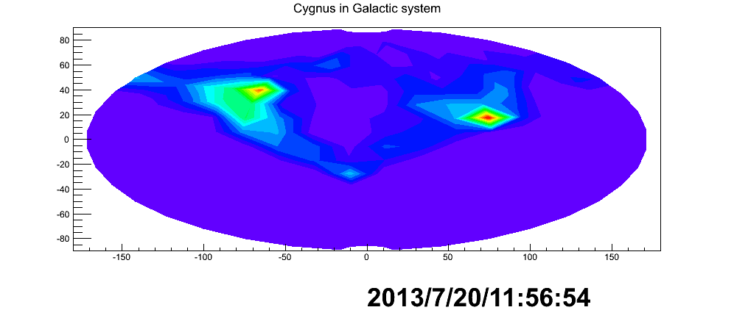
Detection efficiency in Galactic-coordinate
  Time variation of the efficiency map in the galactic coordinate
lab-coordinate
  auto-scanning is demonstrated
  “vertical” and “horizontal” detectors would be needed
galactic coordinate
galactic latitude
galactic longitude
Notes:
30㎝角のμPIC+30㎝のdriftを使ったガスTPCです。

Slide 22
Galactic-plane sky-map
  correlation with
  efficiency
  = consistent with
  isotropic
lab-coordinate
galactic coordinate
+時間情報
Notes:
30㎝角のμPIC+30㎝のdriftを使ったガスTPCです。

Slide 23
NEWAGE
R&Ds

Slide 24
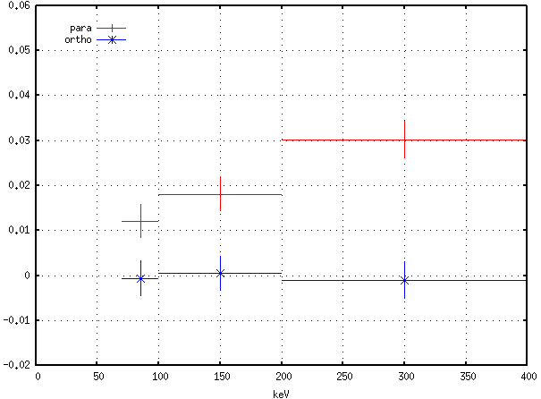
Head/tail study
Head tail in X-Y plane by Cygnus 2013
Head tail in Z-axis <- NEW
7.1σ
5.1σ
CYGNUS2013
for X-Y plane
4.1σ
skewness
Notes:
30㎝角のμPIC+30㎝のdriftを使ったガスTPCです。

Slide 25
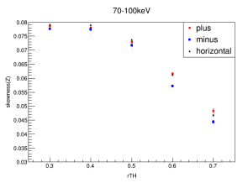
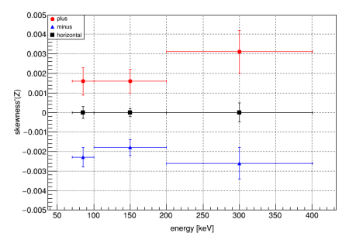
Head tail in Z-axis
  skewness in FADC signal
Z方向
analysis threshold relative to the pulse peak
Though discrimination is still primitive,
  irradiation is not ideal
  analysis is not optimized
We are ready to detect 3-D vector-like tracks.

Slide 26
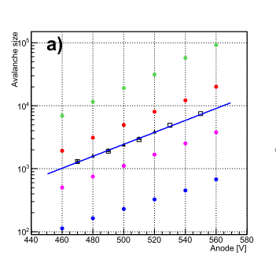
NEWAGE with Garfield++
μPIC 3D simulations with free softwares (Takada)
  gmesh + elmer + garfiled
  For geometry designing, gas studies, electronics designing
JINST8 (2013) C10023
Notes:
30㎝角のμPIC+30㎝のdriftを使ったガスTPCです。

Slide 27
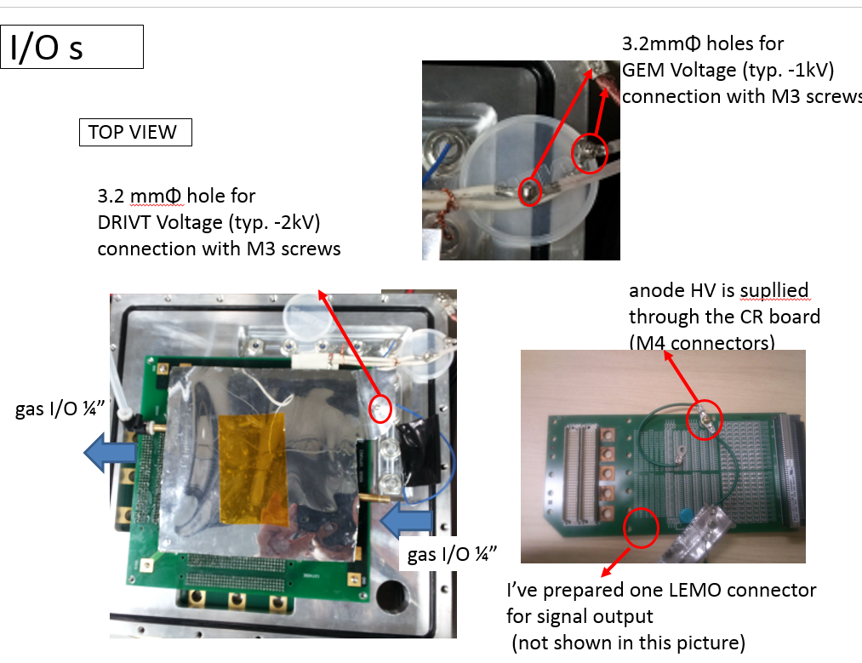
NEWAGE with CYGNUS
μPIC test with CS₂ gas (planned)
  @ Occidental college
  @ Kobe (with chemistry people)
I’ｍ with my uPIC here.
Notes:
30㎝角のμPIC+30㎝のdriftを使ったガスTPCです。

Slide 28
SUMMARY
μ-PIC based TPC with electronics
3-D tracks
Phase for “low BG detector”

